Slide 1
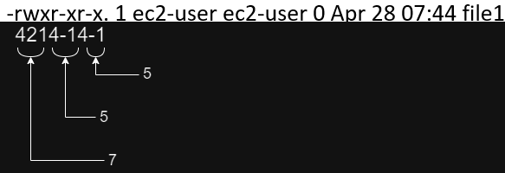
File Permissions (Symbolic and Numeric [Octal])
We learned about Symbolic Notations in Part 3 when we talked about:
r (read), w (write) , x (execute), and - (none) permissions
The symbolic notations are also represented as Numeric Notations:
4 (read), 2 (write), 1 (execute), and 0 (none) permissions
Example:
touch file1
ls -l
chmod 755 file1

Slide 2
Linux sudo permissions
Generally, in real-time scenarios, you would not be allowed to SSH to Linux systems as root. You would be given a sudo user.
Example: Log in as ec2-user (which is a sudo user)
sudo useradd admin
sudo passwd admin
su - admin
sudo yum update
(permission denied as this user is not a sudo user yet)
log in as ec2-user again
sudo usermod -aG wheel admin
su - admin
sudo yum update
(command ran successful as admin is a sudo user now)

Slide 3
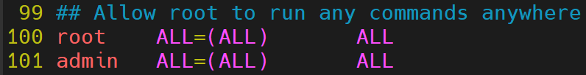
Linux sudo permissions (contd.)
Another way of making a user, a sudo user:
Example: log in as ec2-user
sudo visudo or sudo vim /etc/sudoers
:x
su - admin
sudo yum update
(command will run successfully)

Slide 4
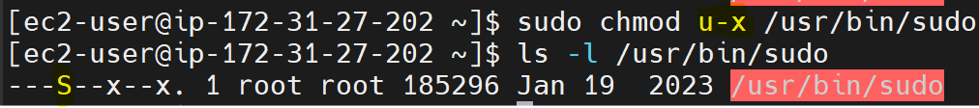
Special Permissions
SUID (Set User ID): Applies to files and used when we want to run executable files or commands as the owner (generally root), no matter who runs them on the system.
Note: There are pre-existing binaries/executables/commands having SUID set.
find / -perm -u=s -type f
chmod u+s filename
chmod u-s filename

Slide 5
SUID Example
su - admin
sudo yum update
Now, open another terminal with either root or ec2-user, run:
ps -ef | grep sudo
You will see a process named sudo yum update owned by root even though it is being run by admin

Slide 6
Special Permissions (SGID)
SGID (Set Group ID): Like SUID, instead of user permissions, you get group permissions, and it is applied on both files and directories.
When applied on a file: The file is always executed as the group of that file.
When applied on a directory: Any new files created will be group-owned by the directory group.
Use Case: Collaborative Task: Infra and Dev Team needs a directory which could be shared by both teams and all files could be modified by team members of both teams.
chmod g+s /shared
chmod g-s /shared

Slide 7
SGID Example
log in as ec2-user:
sudo mkdir /shared
ls -ld /shared
sudo chmod a=rwx /shared or sudo chmod 777 /shared
sudo useradd dev
sudo passwd dev
su - dev
vim /shared/dev
ls -l /shared

Slide 8
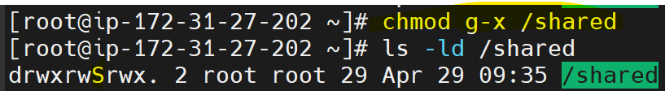
SGID Example (contd.)
login as ec2-user
sudo chmod g+s /shared/
su - dev
touch /shared/dev2
ls -l /shared

Slide 9
Special Permissions (Sticky Bit)
Sticky Bit: With this set, the users can only delete files or directories they own.
Use Case: There are 2 developers (dev1 and dev2) part of dev team. They both share a directory /shared2 on a RHEL system. We must find a way to restrict each of them to not able to delete files under /shared2 directory which they do not own.
chmod o+t /shared2
chmod o-t /shared2
Example: Login as root
mkdir /shared2
ls -ld /shared2
chmod g+w /shared2
ls -ld /shared2
groupadd dev
chgrp dev /shared2

Slide 10
Sticky Bit (Contd.)
useradd -g dev dev1
useradd -g dev dev2
id dev1
id dev2
passwd dev1
passwd dev2
su - dev1
touch /shared2/dev1
su - dev2
rm /shared2/dev1
ls -l /shared2
ctrl +d (become root)

Slide 11
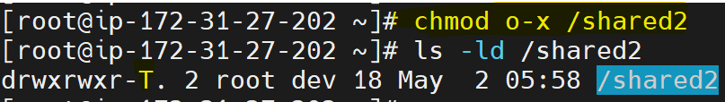
Sticky Bit (Contd2.)
chmod o+t /shared2
ls -ld /shared2
su - dev1
touch /shared2/dev1
su - dev2
rm /shared2/dev1
rm: cannot remove '/shared2/dev1': Operation not permitted

